Slide 1
Jupyter Notebooks
The Jupyter Notebook is an interactive computing environment that enables users to author notebook documents that include: - Live code - Interactive widgets - Plots - Narrative text - Equations - Images - Video
These documents provide a complete and self-contained record of a computation that can be converted to various formats and easily shared with others.

Slide 2
Jupyter Notebook
The Jupyter Notebook combines three components:
The notebook web application: An interactive web application for writing and running code interactively and authoring notebook documents.
Kernels: Separate processes started by the notebook web application that runs users’ code in a given language (Python in our case) and returns output back to the notebook web application.
Notebook documents: Self-contained documents that contain a representation of all content visible in the notebook web application, including inputs and outputs of the computations, narrative text, equations, images, and rich media representations of objects. Each notebook document has its own kernel.

Slide 3
The Notebook
Notebook documents contain the inputs and outputs of an interactive session as well as narrative text that accompanies the code but is not meant for execution.
It is a complete and self-contained record of a computation.
Notebooks consist of a linear sequence of cells. The most important kind of cells are
Code cells: Input and output of live code that is run in the Python kernel
Markdown cells: Narrative text written in Markdown, a lightweight markup language
https://github.com/adam-p/markdown-here/wiki/Markdown-Cheatsheet

Slide 4
The Notebook dashboard
When you first start the notebook server, your browser will open to the notebook dashboard. The dashboard serves as a home page for the notebook. Its main purpose is to display the notebooks and files in the current directory.
Create a new
Notebook

Slide 5
The Notebook Document
Insert new cells
Edit/format cells
Move cells around in the document
Shutdown the notebook document

Slide 6
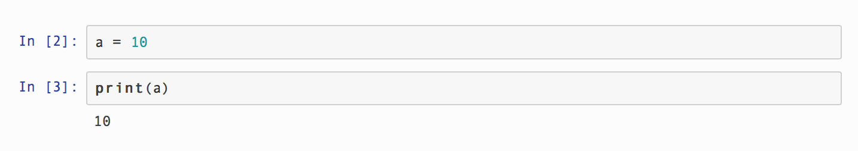
Code Cells
First and foremost, the Jupyter Notebook is an interactive environment for writing and running code.
The notebook is capable of running code in a wide range of languages. However, each notebook is associated with a single kernel. Our notebooks are associated with the IPython kernel, therefore runs Python code.
Code cells allow you to enter and run code.
Run
Cell
Code Cells
Variable definitions carry across cells in a single document!

Slide 7
The Kernel
Code is run in a separate process called the Kernel. The Kernel can be interrupted or restarted.
Most useful menu points:
Restart & Clear Output – create a fresh instance of the kernel, allows you to load a new copy of modules etc and clears all the output fields.
Restart & Run All – create a fresh instance of the kernel and rerun all the code cells in the Notebook

Slide 8
Saving the Notebook
Save Notebook
Become ipynb –files, ‘ipython notebook’
Rename
Manage checkpoints

Slide 9
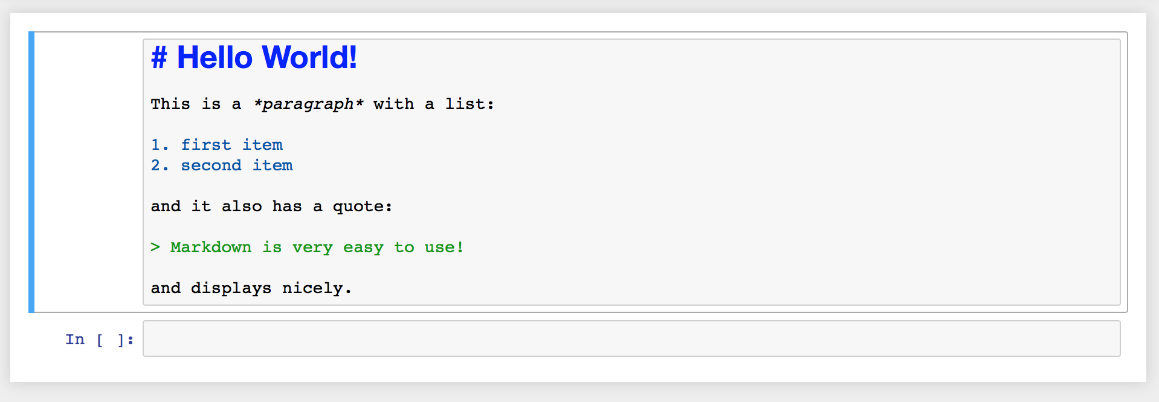
Markdown Cells
Format

Slide 10
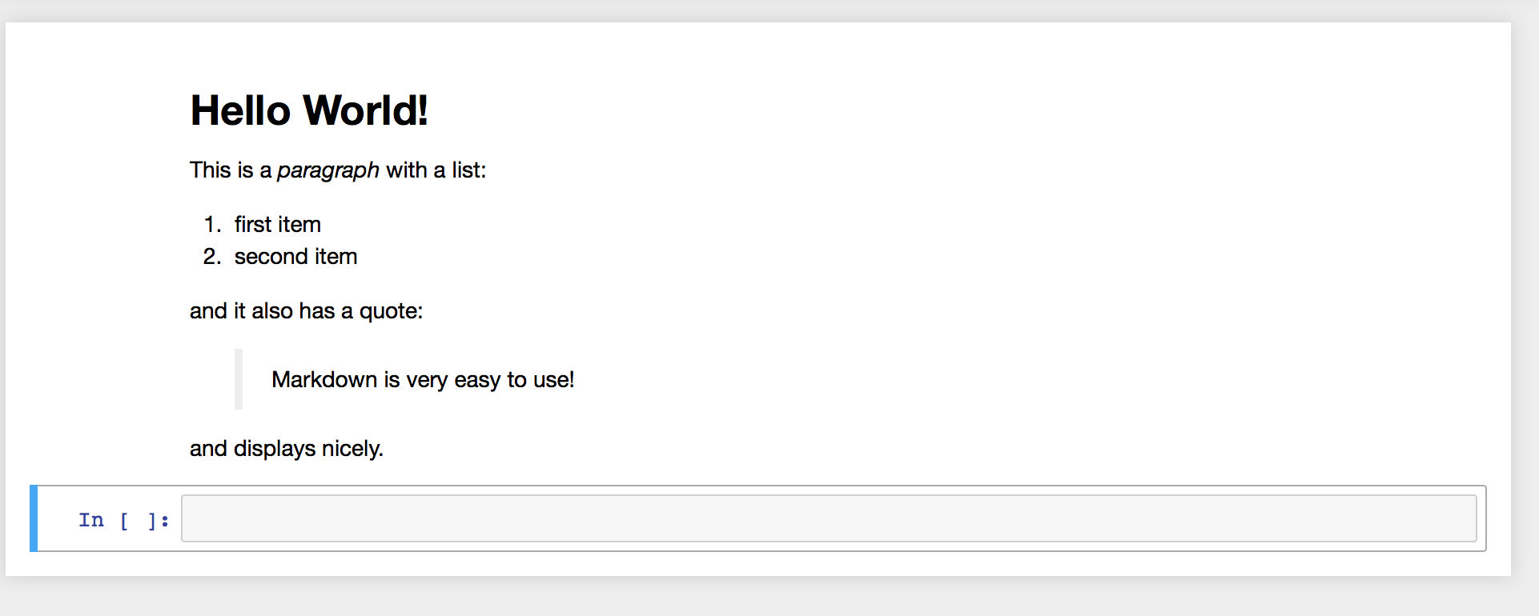
Markdown Cells

Slide 11
Demo
…

